Slide 1
KARIITHI ANNE
EMERTXE INTERNSHIP IOT B2

Slide 2
INTRODUCTION TO C PROGRAMMING
C is a general purpose language used and applied in various specific domains.
It is efficient and portable
It has libraries that play an important role in its general structure.
It is a free-formatted language.

Slide 3

DATA REPRESENTATION NUMBER SYSTEMS
A number can be represented in the forms below;
- Binary(base 2)
- Octal(base 8)
- Decimals(base 10)
- Hexadecimal(base 16)

Slide 4
Introduction to Arduino
What is Arduino?
An easy-to-use Electronic platform with both hardware and software components that allows it to read inputs such as press of button, light on a sensor and turn it into an output such as turning on a motor
Motivation for learning Arduino
Problem-solving
Simulations
Research
Prototyping
Fun 😁😁😁😁!!

Slide 5
…DATA TYPES
DEFINITION:
Are of different types:
Int ; is the primary datatype; stores 2-byte values
Boolean; holds true or false eg. Boolean Val =true;
Float; holds numbers with decimal points eg. float num = 1.222;
Double ; can hold both real integers and floating point numbers
Char; stores character values eg. char char_b = ‘a’;
void ;used in function declaration

Slide 6
…DATA TYPES
DEFINITION:
Diving deeper!!!!
Used to declare variables or functions
Determines how much space a data occupies in the storage
And how its bit patterns are stored and interpreted
Are of different types: int, Boolean, float, double, char, void and String

Slide 7
…VARIABLES
TYPES:
Are of different types:
LOCAL VARIABLES
Only visible inside the function in which they are declared in.
Ensures that every function uses its own variables; and ensures that a function has access to its own variables.
Void loop (){
//statements
}
//local variables
Void loop ()
{
int x , y ;
int z ; Local variable declaration
x = 0;
y = 0; actual initialization
z = 10;
}

Slide 8
…VARIABLES
TYPES:
Are of different types:
GLOBAL VARIABLES
Defined inside a function and can be used by any function inside the program
float c =0; //global variables
Void setup (){
//statements
}
//local variables
Void loop ()
{
int x , y ;
int z ; Local variable declaration
x = 0;
y = 0; actual initialization
z = 10;
}

Slide 9
Introduction to Arduino Language
What is known so far
Structure of Arduino file/sketch? Void setup, void loop
Data types in Arduino Language: int, Boolean, float, double, char, void and String
Control Statements: break, continue, do..while,else,if,for,return,switch..case,while
Arithmetic operators: %, *, +, -, /, =
Comparison Operators: !=,<,<=,==,>,>=
Boolean Operators: !,&&,||
Bitwise Operators: &,|,~

Slide 10
…Program Structure
STRUCTURE:
It is divided into three
Structure
Values(Variables and constants)
Functions

Slide 11
…Program Structure
STRUCTURE:
Diving deeper!!!!
Void setup()
{
-It is where the program execution starts and it only runs once.
-used to initialize(specifying the initial value) variables, pin-modes, libraries
}

Slide 12
…Program Structure
STRUCTURE:
Diving deeper!!!!
Void loop()
{
-Runs multiple times
-loops through the program allowing it to change and respond
}

Slide 13
…OPERATORS
TYPES:
Arithmetic ;used for mathematical operations +,=,-,*,%
Comparison; used to compare two variables ==,!=,<>
Boolean; true or false logical operator &&(non zero=1) ||(zero = 0)
Bitwise ; & || (shift left<< )(shift right>>) (^; xor-same =0)

Slide 14
…CONTROL STRUCTURES
TYPES:
IF OPERATOR
IF..ELSE
IF..ELSE IF..ELSE
SWITCH CASE
WHILE
FOR LOOP

Slide 15
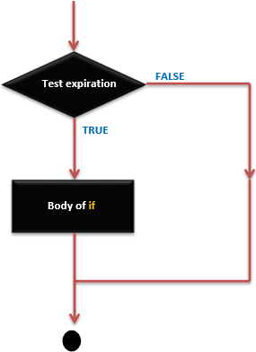
…CONTROL STRUCTURES
/* Global variable definition */
int A = 5 ; int B = 9 ;
Void setup ()
{
}
Void loop ()
{
/* check the boolean condition */
If ( ( A < B ) && ( B != 0 )) /* if condition is true then execute the following statement*/
{
A += B;
B--;
}
}
TYPES:
IF OPERATOR

Slide 16
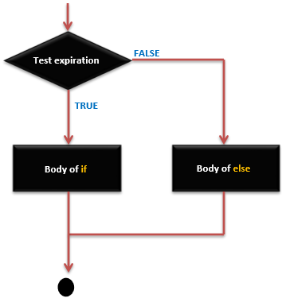
…CONTROL STRUCTURES
/* Global variable definition */
int A = 5 ; int B = 9 ;
Void setup ()
{
}
Void loop ()
{
/* check the boolean condition */
If ( ( A > B ) /* if condition is true then execute the following statement*/
{
A ++;
}
else {
B -= A;
}
}
TYPES:
IF ELSE OPERATOR

Slide 17
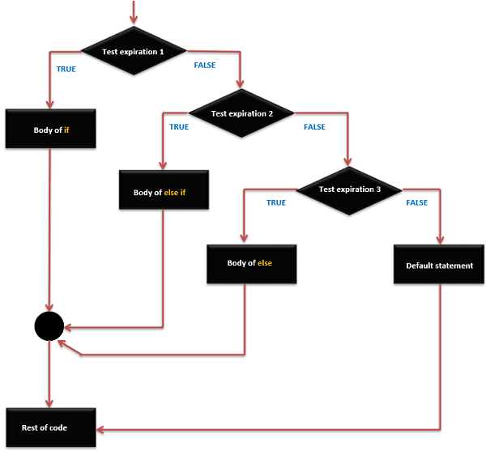
…CONTROL STRUCTURES
/* Global variable definition */
int A = 5 ; int B = 9 ;
Void setup ()
{
}
Void loop ()
{
/* check the boolean condition */
If ( ( A > B ) /* if condition is true then execute the following statement*/
{
A ++;
}
else if ( ( A < B ) && ( B != 0 ))
C= B*A;
}
else {
C++;
}
}
TYPES:
IF ELSE IF..ELSE OPERATOR

Slide 18
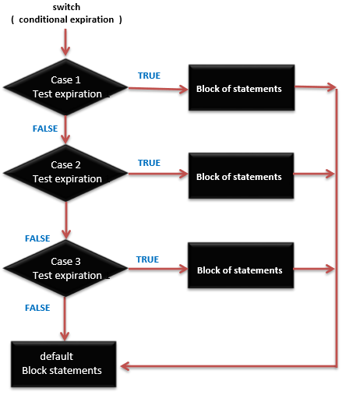
…CONTROL STRUCTURES
TYPES:
SWITCH CASE
/* Global variable definition */
int counter;
Void setup ()
{
}
Void loop ()
{
switch (phase)
{
case 0: Lo(); //call low function
break;
case 1: Mid(); //call medium function
break;
case 2: Hi(); //call high function
break;
default: Message("Invalid state!");
}
}

Slide 19
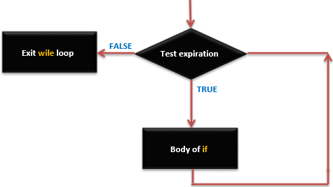
…CONTROL STRUCTURES
TYPES:
WHILE
Checks condition first, then executes statements
/* Global variable definition */
int counter;
Void setup ()
{
}
Void loop ()
{
while (A<B)
{
int sum; /*local variable*/
sum = A+B;
}
}

Slide 20
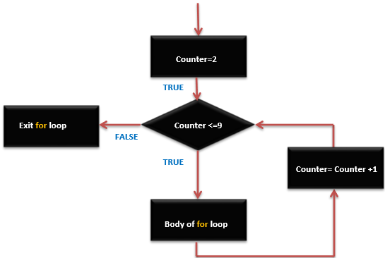
…CONTROL STRUCTURES
TYPES:
WHILE
Checks condition first, then executes statements
/* Global variable definition */
int counter;
Void setup ()
{
}
Void loop ()
{
for (initialize; condition; increment or decrement)
{
/**/pprint values of the counter
Serial.Println (“Values:,+counter”);
}
}

Slide 21
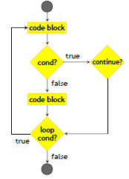
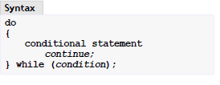
…CONDITIONAL CONSTRUCTORS
TYPES:
CONTINUE
It causes a jump to the loop-continuation portion, that is, to the end of the loop body.
The execution of the code appearing after the continue will be skipped.

Slide 22
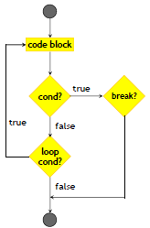
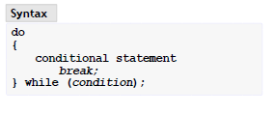
…CONDITIONAL CONSTRUCTORS
TYPES:
BREAK
Break statement shall appear only in switch body or a loop
It is used to exit the loop, the statements appearing after break will be skipped

Slide 23
…ARRAYS
Arrays are very important data structures which are basically a collection od related items and are of a fixed length.
The variable declaration we learned so far occupies a single location of memory, on the other hand array occupies a consecutive collection of memory.
The elements of the array must be of the same time.
The first element has the lowest address and the last element has the highest address.
Indexing starts From 0 and should end at array SIZE-1

Slide 24
…CREATING ARRAYS
The following is the syntax for creating an array..
arrayRefVar = new dataType[arraySize];
The above statement does two things:
• It creates an array using new dataType[arraySize];
• It assigns the reference of the newly created array to the variable arrayRefVar.
Arrays are processed using either loops or foreach loop because all of the elements are of the same type and the size of the array is known.

Slide 25
…POINTERS
Pointers are used to store the addresses of variable or a memory location.
This variable can be of nay data type int. char, function, array and any other pointer.
Void pointer can hold address of any type of a variable. The size of the pointer depends on he computer architecture , that is,
32 bit system = 4 Bytes
64 bit system = 8 Bytes
Syntax is as follows:
Datatype *var_name

Slide 26
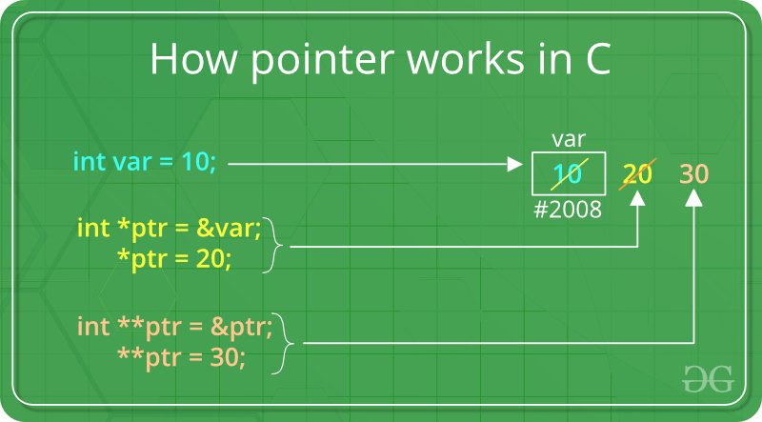
…POINTERS
- Add a & on variable to store its address in a pointer.
- Add a * on the pointer to extract the value of variable it is
pointing to.
#include <stdio.h>
int main ()
{
int x;
int *ptr;
x=10;
ptr = &x; /*returns the address location of x=10*/
return 0;
}

Slide 27
Storage and Pre processor
There are four different storage classes in C language. This include:
Automatic storage classes-default storage classes for the variables
External storage classes-used for giving reference of any goal variable visible to the files of the present program
Static storage classes-Gives an instruction to the compiler to keep the given local variable.
Register storage classes-Used for defining the local variable that must be stored in any register and not in the RAM. Maximum size of this variables s equal to that of the register size.
Storage classes determines the variable’s lifetime, visibility and its scope.

Slide 28
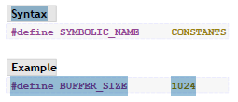
……..storage and Pre processor
A header file is a file containing C declarations and macro definitions to be shared between several source files.
The C pre-processor directive to be included is #include
Header files are defined once and are used to :
Declare the interfaces to parts of the operating systems by implying the definitions and declarations you need to invoke system calls .
Ab macro on the other hand is a simple identifier that is used to give symbolic names to numeric constants.

Slide 29
INTERNET OF THINGS
Internet of things describes the network of physical objects that are embedded with sensors, software and other technologies for the purpose of connecting and exchanging data with other devices and systems over the internet.
IoT achieves seamless communication between people , processes and things.
By means of low cost computing, the cloud, big data, analytics and mobile technologies, physical things can share and collect data with minimal human interventions.
IoT is re-inventing the automobile by enabling connected cars, upgrade in automotive industries, transport and logistics, retail and in the manufacturing sector.

Slide 30
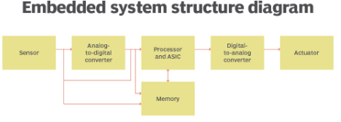
EMBEDDED SYSTEMS
Combination of hardware and software designed and intended for a specific task.
The types of embedded systems include, standalone, networked and real time embedded systems.
Embedded systems work as part of a complete device which are low-cost, low-power-consuming, small-computers that are embedded in other mechanical or electrical systems.
They use communication ports to transmit data between the processor and peripheral devices using communication protocols.

Slide 31
IOT PROJECT
The project requires us to come up with an IoT system that allows us to:
Control the garden lights(Led's) using an LDR sensor.
-When there is sunlight , the garden lights are to switch off automatically.
-When there is no sunlight, the garden lights should turn on automatically.

Slide 32
……IOT PROJECT
Switch the cooler and heater on and off depending on the room temperature and displaying their status on the terminal notification bar and the CLCD using blynk application.
-When the room temperature is above 35 degrees Celsius, the heater will automatically turn off or can be turned on from the blynk application as will be seen in the presentation.
Open and close the serial tank inlet and outlet valves using the blynk application depending on the volume of water in the tank.
-If the volume of the tank is equal to 2000l, then the inlet valve will be turned on through the Blynk application. And the tank status will be relayed on the terminal notification bar as well as the CLCD in the picsimlab.

Slide 33
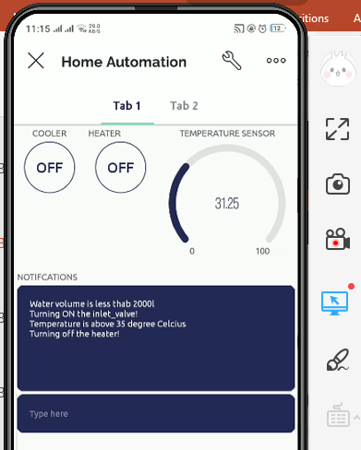
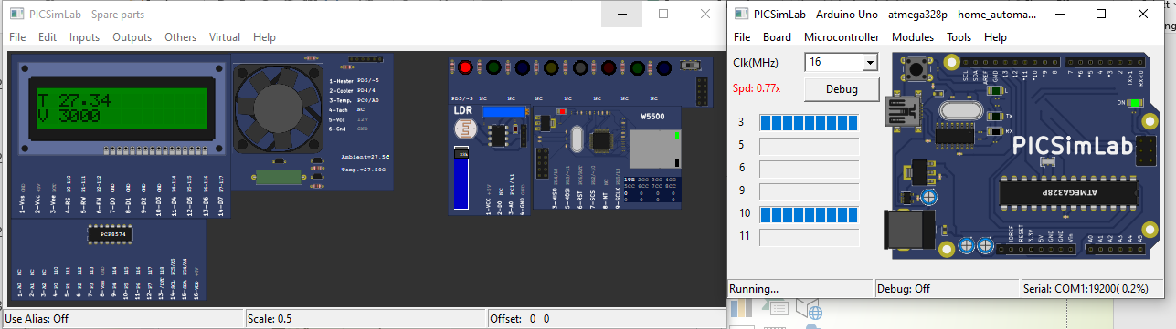
PICSIMLAB IMPLEMENTATION COMPONENTS: LED,LDR SENSOR, CLCD, ETHERNET SHIELD,TEMPERATURE SENSOR, ARDUINO BOARD

Slide 34
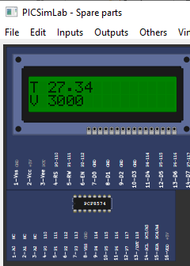
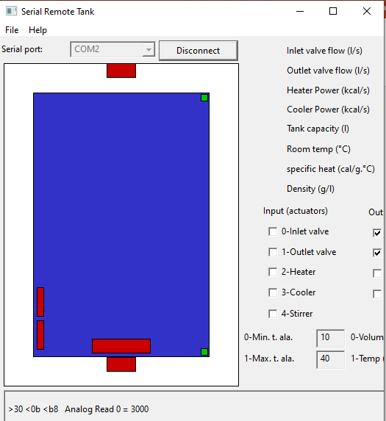
PICSIMLAB IMPLEMENTATION COMPONENTS: LED,LDR SENSOR, CLCD, ETHERNET SHIELD,TEMPERATURE SENSOR, ARDUINO BOARD
The volume of the serial tank is 3000l full, both the inlet and outlet valve on the serial monitor are closed, and the volume status is displayed on the picsimlab CLCD.

Slide 35
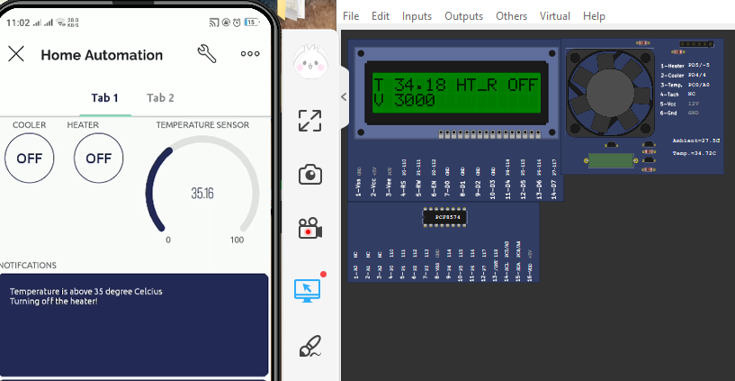
PICSIMLAB IMPLEMENTATION COMPONENTS: LED,LDR SENSOR, CLCD, ETHERNET SHIELD,TEMPERATURE SENSOR, ARDUINO BOARD
The heater goes off when temperature is above 35 and immediately sisplays on the terminal , and the system automatically switches the heater off and temperatures start dropping.

Slide 36
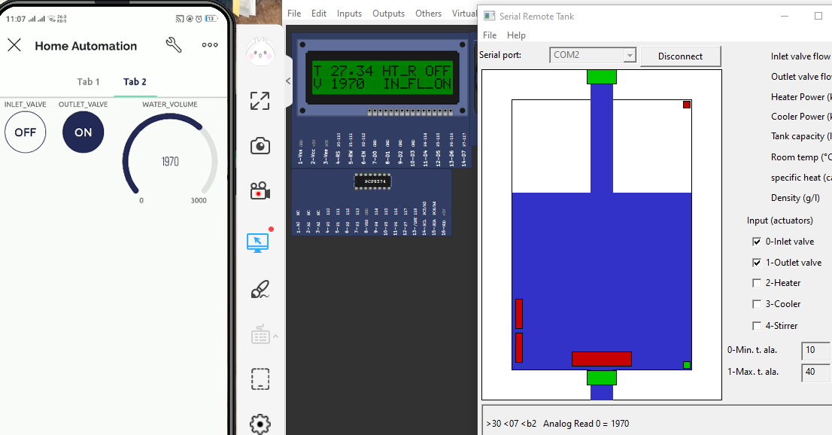
PICSIMLAB IMPLEMENTATION COMPONENTS: LED,LDR SENSOR, CLCD, ETHERNET SHIELD,TEMPERATURE SENSOR, ARDUINO BOARD
When water goes below 2000 liters the inlet valve is automatically turned on by the system. We can control the on and off states of the valves using the blynk application on the side as shown. The water volume gauge shows the current volume of water in the tank as well as the CLCD.

Slide 37
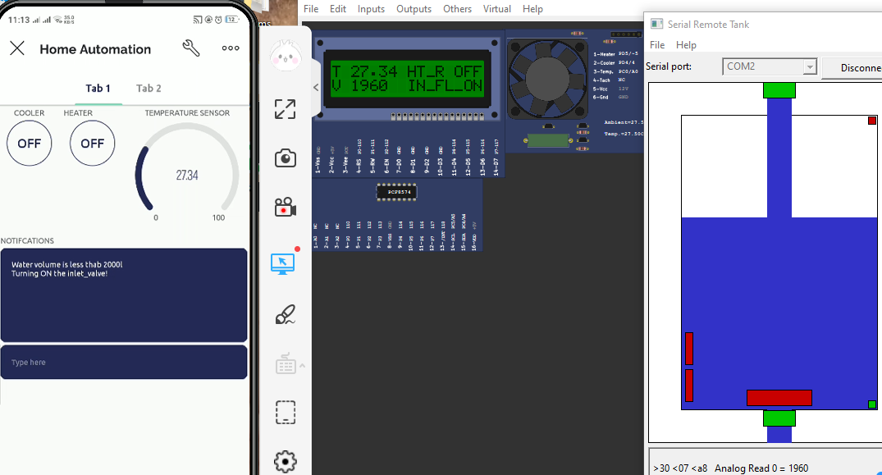
PICSIMLAB IMPLEMENTATION COMPONENTS: LED,LDR SENSOR, CLCD, ETHERNET SHIELD,TEMPERATURE SENSOR, ARDUINO BOARD
The status of the tank is displayed on the notification bar of the blynk application

Slide 38
THANKYOU

